Slide 1
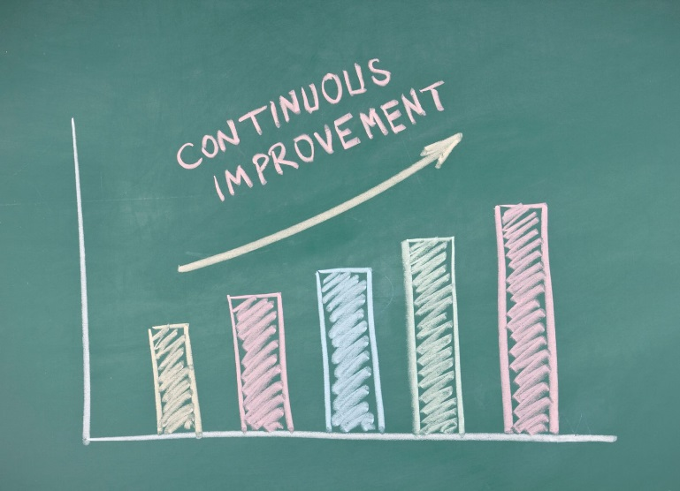
Continual Service Improvement (CSI)
Itil V3

Slide 2
CSI Overview
You cannot manage what you cannot control.
You cannot control what you cannot measure.
You cannot measure what you cannot define.

Slide 3
CSI Goal
The primary purpose of CSI is to continually align and realign IT services to the changing business needs by identifying and implementing improvements to IT services that support business processes.
In effect, CSI is about looking for ways to improve process effectiveness, efficiency as well as cost effectiveness.

Slide 4
CSI Objective
Review, analyze and make recommendations on improvement opportunities in each lifecycle phase: Service Strategy, Service Design, Service Transition and Service Operation.
Review and analyze Service Level Achievement results.
Identify and implement individual activities to improve IT service quality and improve the efficiency and effectiveness of enabling ITSM processes.
Improve cost effectiveness of delivering IT services without sacrificing customer satisfaction.
Ensure applicable quality management methods are used to support continual improvement activities.

Slide 5
CSI Scope
There are three main areas that CSI needs to address:
The overall health of ITSM as a discipline;
The continual alignment of the portfolio of IT services with the current and future business needs;
The maturity of the enabling IT processes for each service in a continual service lifecycle model

Slide 6
Value to the Business
There are four ways to measure value :
Improvements
Measurements that compare “before” with “after”.
Benefits
- The gains achieved through realization of improvements, usually expressed in monitory terms
Return on Investment (ROI)
The difference between the benefit achieved and the amount spent, expressed as a percentage.
Value on Investment (VOI)
- The extra value created by establishment of benefits that include non monetary or long term outcomes.
CSI on its own will not be able to achieve the desired results – it needs to work in collaboration with the other Lifecycles.

Slide 7
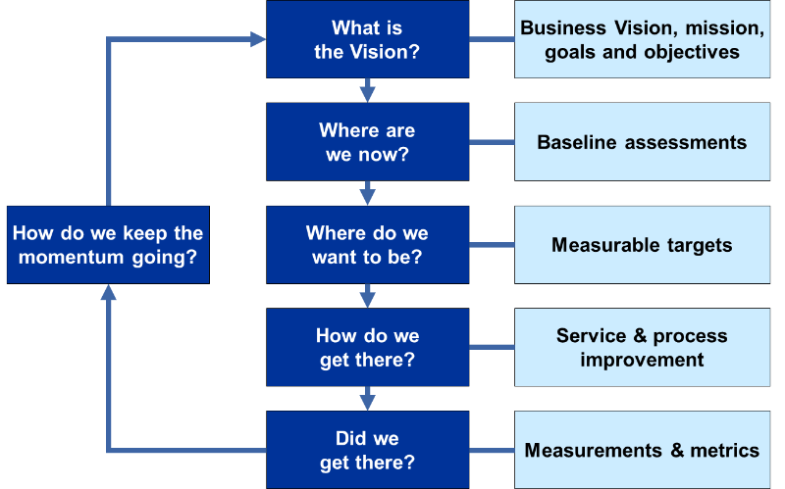
The CSI Model

Slide 8
Measurement
Service Measurement is the ability to predict and report service performance against targets of an end-to-end service. This will require someone to:
Take individual measurements and combine them to provide the view of the customer experience.
- Analyze the data over time to produce trends.
This data can be collected at multiple levels (ex CI, Processes, services).

Slide 9
There are four reasons to monitor and measure
To validate = monitoring and measuring to validate previous decisions;
To direct = monitoring and measuring to set direction for activities in order to meet set targets. It is the most prevalent reason for monitoring and measuring;
To justify = monitoring and measuring to justify, with factual evidence or proof, that a course of action is required;
To intervene = monitoring and measuring to identify a point of intervention including subsequent changes and corrective actions.

Slide 10
Types of Metrics
Technology Metrics : These are often associated with component and application based metrics such as performance, availability etc.
Process Metrics: These are captured in as CSFs, KPIs and activity metrics for the Service Management processes. They can help determine the overall health of a process.
Critical Success Factors (CSF): Something that must happen if a Process, Project, Plan or IT Service is to succeed. KPIs are used to measure the achievement of each CSF.
Key Performance Indicator (KPI): A Metric that is used to help manage a Process, IT service or Activity. Many metrics can be used as measures but only the most important of these are defined as KPIs. Four key questions that KPIs help to answer are around quality, performance, value and compliance.
Service Metrics : These metrics are the results of end-to-end service.
Component metrics are used to compute Service metrics.

Slide 11
Governance
Governance has been around the IT arena for decades. The mainframe had significant controls built around its day-today operations. But it came into action since the early 2000’s as a result of mainly high level of corporate fraud.
IT organizations are now required to be much more answerable for the money which they spend, and for the benefits which they bring to the organization.

Slide 12
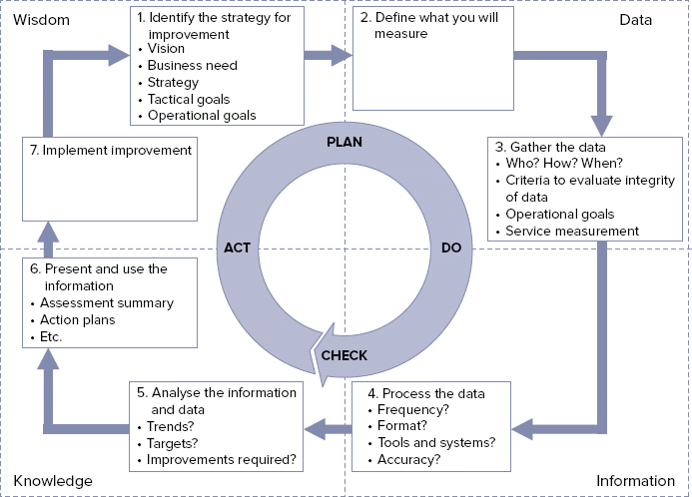
Seven Step Improvement Process

Slide 13
Roles: Continual Service Improvement Manager
Ultimately responsible for success of all improvement activities.
Communicates the CSI vision across the IT organization.
Defines and reports on the CSI, KPI and CSI activity metrics.
Works with the service owner to identify and prioritize improvement opportunities.
Works with the Service Level Manager to ensure that monitoring requirements are defined .
Works with Service Level Manager to identify Service Improvement Programs.
Ensures that Knowledge management is an integral part of day to day activities.
Reviews analyzed data.

Slide 14
There are four functions covered
- Service Desk;
- Technical Management;
- Application Management;
- IT Operations Management;

Slide 15
Service Desk
Different options : Depending upon the business need, service desks may be of the following kinds
Local Service Desk;
Central Service Desk;
Virtual Service Desk;
Follow- the- Sun;
Specialized Service Desk Groups.

Slide 16
Roles: Technical Management
Technical Managers/ Team- Leaders;
Technical Analyst/Architect;
Technical operator.

Slide 17
Roles: IT Operations Management
IT Operations Manager
Shift Leaders:
IT Operations Analysts

Slide 18
Roles: Application Management
Application Manager/Team Leaders
Application Analyst/Architect

Slide 19
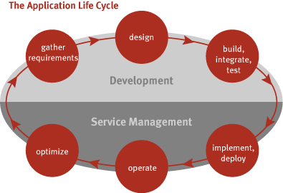
Application Management Lifecycle
The lifecycle followed to develop and manage applications has been referred to by many names, including the Software Lifecycle (SLC) and Software Development Lifecycle (SDLC).

Slide 20
References
The CSI approach and also the 6-Step CSI Model
http://www.qmsacademy.com/csi-approach-also-6-step-csi-model/
The Seven-Step Improvement Process
https://www.oreilly.com/library/view/itil-foundation-exam/9781119943648/xhtml/sec84.html

